Slide 1
AN OVERVIEW ABOUT BIG DATA IN SMART GRID
Seçkin CANBAZ
Ocak, 2019
İSTANBUL SABAHATTİN ZAİM ÜNİVERSİTESİ

Slide 2

How Can We Explain Big Data?
- Big data; social media shares, network logs, blogs, photos, videos, log files, such as all the data recovered from a variety of sources are converted into a meaningful and processable format.
Notes:
It is a series of non-structural data that is not used until recent times. According to the informatics belief, which is now destroyed, the non-structural data was worthless, but the big data showed us something which is enormously important, usable and useful from the so-called information dump. Big data; Web servers' logs, Internet statistics, social media broadcasts, blogs, microblogs, climate sensors and information from similar sensors, call records from GSM operators, such as a large number of information consists of.

Slide 3
The features of 5Vs Big Data model
Notes:
There are 5 components in the formation of Big Data. These components are respectively; variety, velocity, volume, verification, and value. It is commonly referred to as 5v.

Slide 4
Büyük Veri (Big Data) Bileşenleri
Variety : Since the data produced are generally non-structural and consist of data formats obtained from many different media, they must be integrated and can be transformed into each other.
Velocity : Big data production is accelerating every day and this data reaches an incredible size per second. The fast growing data results in the increase in the number and variety of transactions that need the data, and we should be able to remove this density both software and hardware.
Volume : Our data, which we call big data, may increase by increasing speed. Therefore, we need to think about how to deal with these masses of data and make our plans accordingly.
Verification : Verification as another data component can also be seen when we need to check if the incoming data is safe during the flow of such rapidly growing data. This data may be seen by the right people or may need to remain hidden.
Value : Perhaps one of the most important layers is the er Value en layer, after the data has been filtered from the above data components, the data obtained in the production and processing layers of the large data must provide added value for our company.
Notes:
There are 5 components in the formation of Big Data. These components are respectively; variety, velocity, volume, verification, and value. It is commonly referred to as 5v.

Slide 5
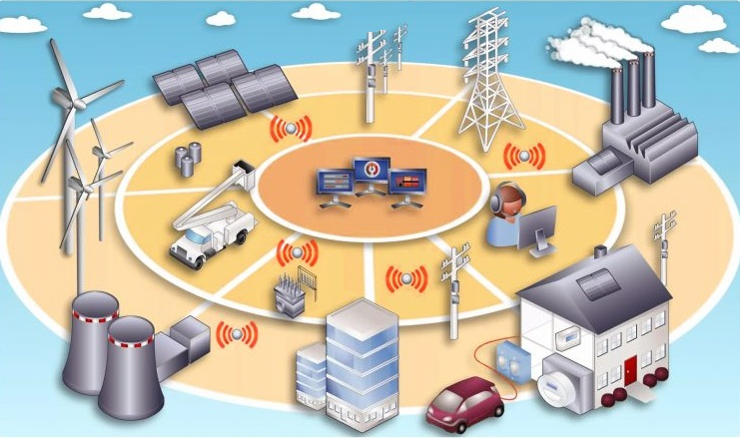
What Is Smart Grid ?
- Smart Grid is the monitoring and control of the electricity grids in order to provide easy and fast communication between the producer and the consumer.
Notes:
During this process it is very important that the electricity is optimized and distributed reliably. The reason why Smart Network is called smart is that digital technology provides two-way communication between service programs and customers. Smart networks such as the Internet also consist of computer, control, new technology, automation and equipment.

Slide 6
What are Smart Grid Benefits?
- Provides more efficient electricity transmission without energy losses.
- Provides rapid improvement of the system after electrical interruption.
- Provides the reduction of cost during the repair and determination of electrical faults and this reflects to consumers as low energy cost.
- It also provides lower energy prices and lower electricity prices.
- The establishment of large-scale and renewable power plants will increase network integration.
- It helps to ensure better integration of the personal or institutional power plants including renewable energy systems into the grid.
- Most importantly developed in terms of security. It has the act of protecting itself against sabotage from outside.
Notes:
Smart Grid, which brings the energy industries into a new era of safe use, is a unique opportunity. It is both beneficial in terms of environmental health and economically very beneficial. The main benefits of the smart network are:
With Smart Grid systems, failures caused by both power outages and power outages are prevented. The intelligent network, which detects the fault location without allowing large scale interruptions, isolates the faults.

Slide 7
Big Data Analysis in Smart Grid
Notes:
As shown in the figure, the first step is to collect data to carry out the analysis. Data can be collected from many sources, such as smart meters, smart devices, and third-party data sets. When data is collected, the next step is data preprocessing. In this step, data is extracted from various sources (in various formats and possibly missing or incorrect values). This data is then cleared to remove the incorrect values. The data is then transferred to the destination store, then the data is loaded into a repository. Now, data analysis techniques are applied to pre-processed data to extract values ​​(ie, information) that some informed actions or decisions can be made. The analyzes performed to extract the value can be divided into three broad categories. consumer analytics, operational analytics and enterprise analytics. Includes consumer analysis, energy forecasting, consumption analysis and theft detection. Includes operational analytics, asset maintenance, downtime management and distribution optimization. Enterprise analytics include real-time grid awareness and visualization of data.

Slide 8
Some Analyzes On Smart Grid With Big Data
The United States Geological Survey (USGS) Datas (First Dataset)
The United States Geological Survey (USGS) is a science bureau within the United States Department of the Interior.
This dataset provides industrial-scale onshore wind turbine locations in the United States, corresponding facility information, and turbine technical specifications. The database has wind turbine records that have been collected, digitized, locationally verified, and internally quality controlled.
Our first dataset includes these datas; FID, unique_id, site_name, total_turb, on_year, year_range, on_year_s, manufac, model, type_tower, decommiss, MW_turbine, total_cpcy, total_ht, tower_h, blade_l, rotor_dia, rotor_s_a, lat_DD, long_DD, state, county, conf_attr, conf_loc, WENDI_name, EIA_name, FAA_jdate, FAA_AGL, FAA_ORS, image_name, image_year, comments

Slide 9
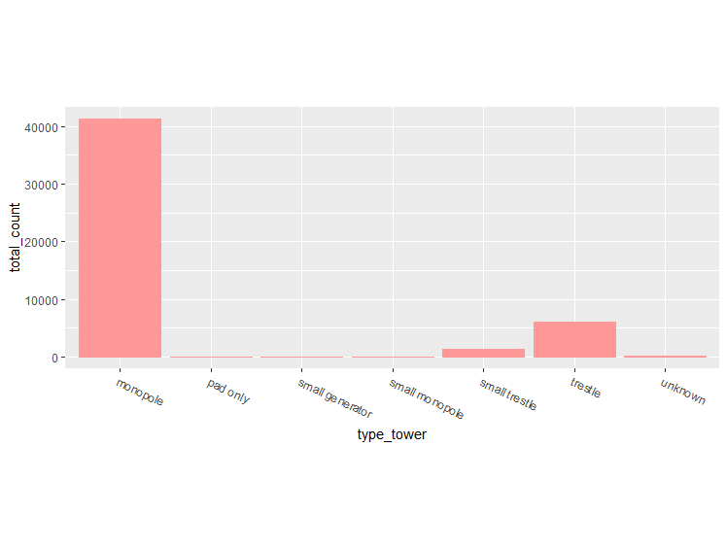
Some Analyzes On Smart Grid With Big Data
The United States Geological Survey (USGS) Datas (First Dataset)
In this graph we have examined the most used turbine types. Monopole was the most commonly used type of turbines. Around 50000 turbines were the most preferred type of monopole. The Monopole Towers were widely used from our 1kW to 50kW wind turbines. Monopole tower has good appearance, reliable structure and easily to be installed. The survival wind speed is 50m/s.
Notes:
turbine_type_group <- group_by(windTurbines, type_tower)
turbine_type <- summarise(turbine_type_group, total_count= n_distinct(unique_id))
ggplot(turbine_type, aes(x=type_tower, y=total_count))+ theme(aspect.ratio=2/5,axis.text.x=element_text(angle = -25, hjust = 0)) +
geom_bar(stat="identity",colour="#FF9999", fill="#FF9999")

Slide 10
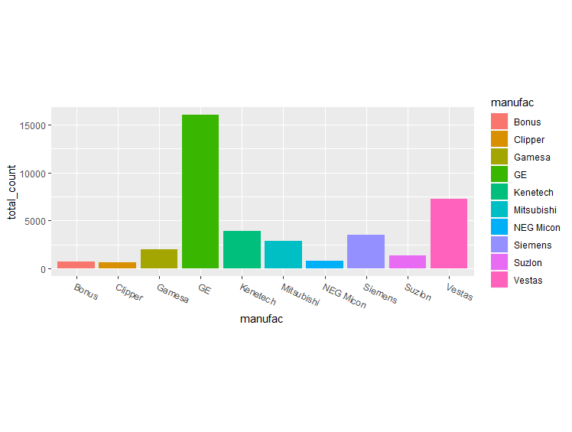
Some Analyzes On Smart Grid With Big Data
The United States Geological Survey (USGS) Datas (First Dataset)
We've found the most used turbine. What is the most preferred manufacturer in America? As you can see from the graphic, GE stands out as the most preferred brand.
Notes:
manufact_group <- group_by(windTurbines, manufac)
manufact_turbine_cnt <- summarise(manufact_group, total_count= n_distinct(unique_id))
manufact_turbine_cnt <- arrange(manufact_turbine_cnt, desc(total_count))
manufact_turbine_cnt <- manufact_turbine_cnt[manufact_turbine_cnt$manufac != 'unknown',]
top_10 <- manufact_turbine_cnt[1:10,]
ggplot(top_10, aes(x=manufac, y=total_count, fill=manufac))+ theme(aspect.ratio=2/5,axis.text.x=element_text(angle = -25, hjust = 0)) +
geom_bar(stat = "identity")

Slide 11
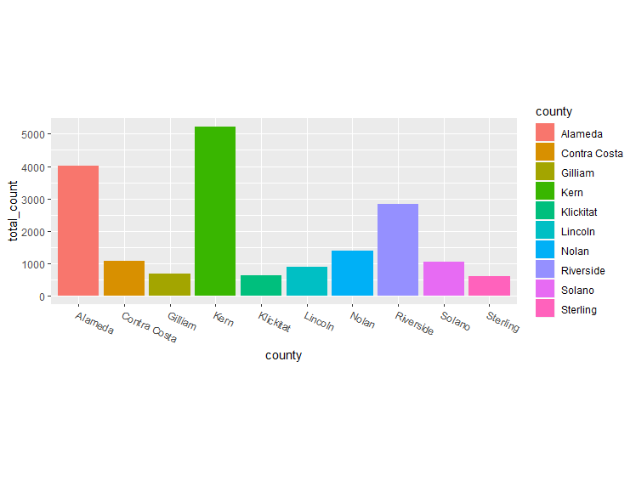
Some Analyzes On Smart Grid With Big Data
The United States Geological Survey (USGS) Datas (First Dataset)
We know the most used turbine type and the most preferred manufacturer. So where are these wind turbines? Which cities are located and which city is the most preferred. As you can see from the graphic below, Kern city is the most preferred city. There are over 5000 wind turbines, then the Alameda is preferred. Why this place is preferred is a separate research topic.
Notes:
#find the top 10 cities against the total number - not including unknown cities
city_group <- group_by(windTurbines, county)
city_turbine_cnt <- summarise(city_group, total_count= n_distinct(unique_id))
city_turbine_cnt <- arrange(city_turbine_cnt, desc(total_count))
city_turbine_cnt <- city_turbine_cnt[city_turbine_cnt$county != 'unknown',]
top_10 <- city_turbine_cnt[1:10,]
ggplot(top_10, aes(x=county, y=total_count, fill=county))+ theme(aspect.ratio=2/5,axis.text.x=element_text(angle = -25, hjust = 0)) +
geom_bar(stat = "identity")

Slide 12
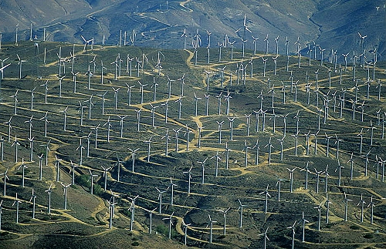
Some Analyzes On Smart Grid With Big Data
The United States Geological Survey (USGS) Datas (First Dataset)
The following photo shows wind turbines in Kern.

Slide 13
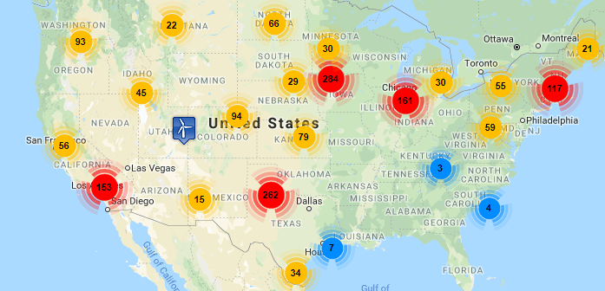
Some Analyzes On Smart Grid With Big Data
OpenEI Datas (Second Dataset)
- This map contains comprehensive wind farm project and installation information in the United States through the end of 2012. - 1146 wind project locations are in service with an installed cumulative wind power capacity of 60,999 MW. - 8 wind project locations are under construction. These locations will add an additional 426 MW of wind power capacity. - This map contains 1785 total wind farm locations, including: in service, under construction and proposed locations. - All locations have a combined wind power capacity with potential for generating up to 87,624 MW .

Slide 14
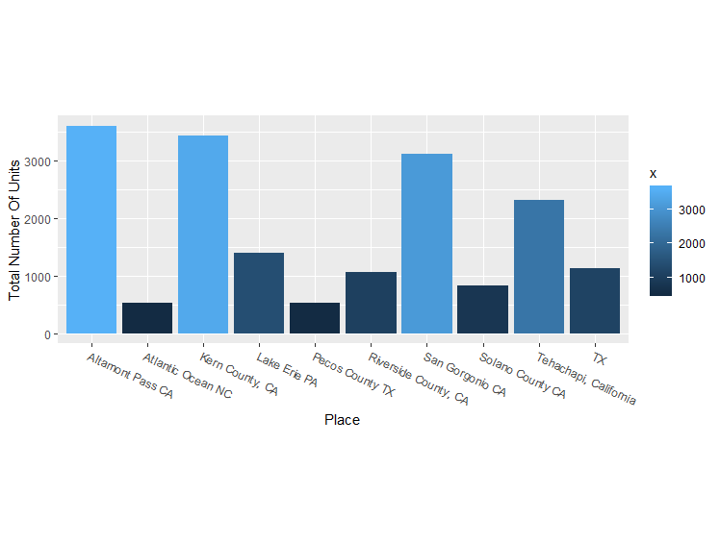
Some Analyzes On Smart Grid With Big Data
OpenEI Datas (Second Dataset)
The following chart shows the number of wind turbines by location. This is a different and updated data set. We can see the difference in the last few years.
Notes:
NumberOfUnitdata <- aggregate(abd2012$NumberOfUnits, by=list(Place=abd2012$Place), FUN=sum)
NumberOfUnitdata <- arrange(NumberOfUnitdata, desc(x))
NumberOfUnitdata <- NumberOfUnitdata[NumberOfUnitdata$Place != 'unknown',]
top_10 <- NumberOfUnitdata[1:10,]
ggplot(top_10, aes(x=Place, y=x, fill=x))+ theme(aspect.ratio=2/5,axis.text.x=element_text(angle = -25, hjust = 0)) +
geom_bar(stat = "identity") + ylab('Total Number Of Units')

Slide 15
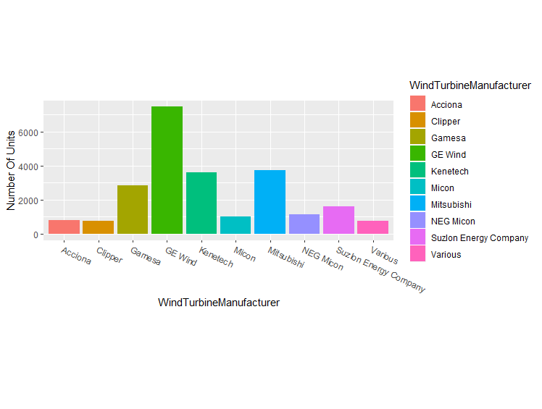
Some Analyzes On Smart Grid With Big Data
OpenEI Datas (Second Dataset)
The following graphic shows the total number of wind turbines found in America by wind turbine manufacturers. As can be seen, GE Wind is a great advantage in terms of numbers.
Notes:
# find the top 10 Manufacturer against the total number of Unit - not including unknown Manufacturer
manufac_group <- group_by(abd2012, WindTurbineManufacturer)
manufac_turbine_cnt <- aggregate(abd2012$NumberOfUnits, by=list(WindTurbineManufacturer=abd2012$WindTurbineManufacturer), FUN=sum)
manufac_turbine_cnt <- arrange(manufac_turbine_cnt, desc(x))
manufac_turbine_cnt <- manufac_turbine_cnt[manufac_turbine_cnt$x != 'NA',]
top_10 <- manufac_turbine_cnt[1:10,]
ggplot(top_10, aes(x=WindTurbineManufacturer, y=x, fill=WindTurbineManufacturer))+ theme(aspect.ratio=2/5,axis.text.x=element_text(angle = -25, hjust = 0)) +
geom_bar(stat = "identity") + ylab('Number Of Units')

Slide 16
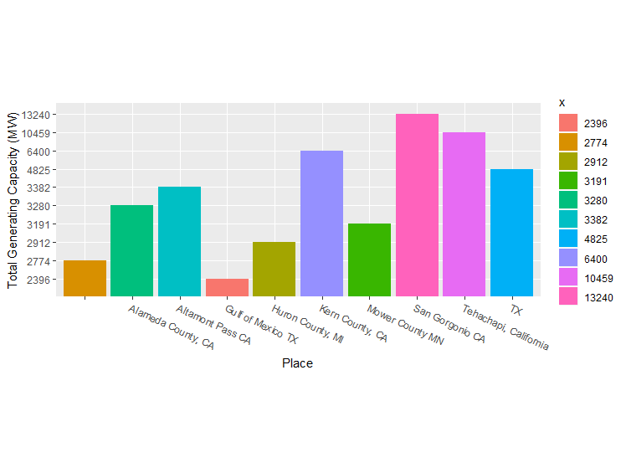
Some Analyzes On Smart Grid With Big Data
OpenEI Datas (Second Dataset)
The following graphic shows the total Generating Capacity of the wind turbines in America by wind turbine locations. As can be seen, San Gorgonio CA is the city with the highest Generating Capacity.
Notes:
# find the top 10 cities against the total Generating Capacity - not including unknown cities
abd2012$GeneratingCapacity <- as.numeric(abd2012$GeneratingCapacity)
GeneratingCapaci <- aggregate(abd2012$GeneratingCapacity, by=list(Place=abd2012$Place), FUN=sum)
GeneratingCapaci <- arrange(GeneratingCapaci, desc(x))
GeneratingCapaci <- GeneratingCapaci[GeneratingCapaci$Place != 'unknown',]
top_10 <- GeneratingCapaci[1:10,]
top_10$x <- as.factor(top_10$x)
top_10
ggplot(top_10, aes(x=Place, y=x, fill=x))+ theme(aspect.ratio=2/5,axis.text.x=element_text(angle = -25, hjust = 0)) +
geom_bar(stat = "identity") + ylab('Total Generating Capacity (MW)')

Slide 17
CONCLUSION
In this project we have worked Big Data on Smart Grid. At first glance, Big Data can be thought of as complex and meaningless data rendering and usable data creation. In Smart Grid, this is also used in this way. The data obtained from any device related to the Smart Grid are processed and made available for use in the next steps and made available.
This study is the preparation stage for the studies to be carried out. We can get the results we want by examining our data to get a result that we have targeted. Or we can do more studies on these results by making meaningful results from a data set that we don't know what to do.

Slide 18
CONCLUSION
For example; In the last graph of our second data set, Total Generating Capacity against to Place, we examined the total energy generated by the wind turbines that were built according to locations. We can get another work out of here. First of all, we can see why there are more Wind Turbines in the city of San Gorgonio than in other cities. Maybe the geographic location of the other provinces to receive more wind. Perhaps because this is the closest location to the regions that need it, in order to be easy to deploy. We would never know without investigating the causes.
The work we did in this project was a little challenging. We had two different data sets. In our data set named “abd2012”, we had 23205 pieces of data. This is a very small data set actually. Our WindTurbines data set is slightly larger. We have 1.567.232 pieces of data. It is not an easy task to get meaningful data from such a large dataset. Of course, if you are dealing with larger data, you should be more prepared.

Slide 19
CONCLUSION
The first thing we did was to upload the data to the R Studio program that we used to examine these complex data. Then, by looking at the data headers, we decided what to do or what we needed. Later, we have simplified the data set by removing the undesirable data. Then we cleared the rows and columns that are meaningless and empty from the remaining data. And in the end we have a meaningful data set. Then we grouped them more comprehensible and finally we use our vision to draw a better interpretation of our data using the graphical function.
Every result we get and each chart is now a new project. After that, decide which one we want to do or which one we need to do and start a new research on those results. It should not be forgotten that this work can prepare a lot of new work.

Slide 20
Where Can You Find My Datas?
You can find the presentation, all R codes, datasets and graphics in my github.
«https://github.com/seckincanbaz/SmartGrid.git»

Slide 21
References
https://openei.org/wiki/Information
https://openei.org/wiki/Data
https://openei.org/wiki/Map_of_Wind_Farms
https://openei.org/wiki/Map_of_Wind_Farms/Data
https://link.springer.com/article/10.1186/s40537-017-0070-y "DOI 10.1186/s40537-017-0070-y"
https://netvent.com/big-data-nedir/
http://www.prowmes.com/blog/akilli-sebeke-nedir/
https://smartgrid.ieee.org/images/files/pdf/big_data_analytics_white_paper.pdf
http://www.windturbinestar.com/monopole-tower.html
https://www.usgs.gov/about/about-us
https://www.kaggle.com/kumarmanish/wind-turbine-data-analysis/log
https://chesterenergyandpolicy.com/2018/05/29/making-energy-data-a-breeze-
the-u-s-wind-turbine-database/

Slide 22

THANK YOU
FOR
LISTENING

